Slide 1
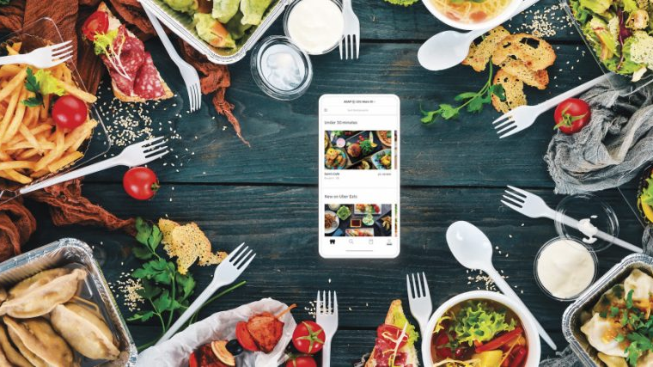
Industry Analysis Bryce Bowles, Hanna Daminski, Rachel Hagerman, Jenifer Jackson & Andrew Mcleod

Slide 2
Food Delivery Background
History
(753 B.C. – 476 A.D.) The first delivery: Thermopolium - ancient Romans in Pompeii
served meals at a counter out of large clay pots that kept the food hot to deliver
(1768) First food delivery service recorded: naengmyeon (cold noodle) in Korea (by bikes)
(1785) Milk Delivery – perishable and needed to be delivered quickly
(1939 – 1945) WWII: London – increased popularity due to bomb threats
(1950s) Fast Food Delivery migrated to US – increased popularity due to TV/Advertisements (Pizza became popular)
(1954) Meals on Wheels started (deliver meals to seniors)
(1994) First Online Food Order - Pizza Hut
(1995) Online Food delivery service company - World Wide Waiter or waiter.com
(2004) Grubhub
By 2008 there were over 3,000 restaurant delivery apps
(2010s) 3rd party Aggregator service: access to a great variety - perhaps they didn’t know existed previously
(2015) Ghost kitchen/restaurant - contains kitchen space and facilities for more than one restaurant brand (for delivery only)
(2019) Starship launched robot food delivery services at George Mason University.
Sub-Industries
First Movers
Grubhub (2004), Pizza Hut (2008), DoorDash (2013), UberEats (2014)
Meal Kit – Blue apron 2012
Grocery delivery – Instacart 2012
3rd party delivery services
Notes:
Real quick let me get a show of hands or shout out if you’ve ever used a food delivery app or service.
The history goes way back to ancient roman times. Artifacts of clay pots and kitchens were found and were believed to be used to store and deliver hot food.
The first delivery service goes back to 1768 in Korea.
It wasn’t until 1950 they started getting more popular in the US due to TV and advertisements.
In 1994, Pizza Hut made the first online food order.
Waiter.com was the first online food delivery company in 95
and Grubhub was established in 2004.
By 2008 restaurants were creating their own apps
and by the 2010’s 3rd party delivery services were being created.
In 2015 Ghost kitchens came about which is sorta like delivery only restaurants.
In 2019 autonomous delivery was first used on a major campus.
First movers are on your bottom right
https://www2.gmu.edu/news/2019-01/there-are-robots-campus-heres-what-you-need-know
https://en.wikipedia.org/wiki/Food_delivehttps://www.smithsonianmag.com/smart-news/romans-loved-fast-food-much-we-do-180971845/ry#:~:text=The%20first%20food%20delivery%20service,in%20the%20newspaper%20in%201906.
https://underscore.factor75.com/the-history-evolution-of-food-delivery/
https://www.thrillist.com/news/nation/history-of-takeout-food-delivery

Slide 3
Products and Innovation
Innovation
Product
Consumers accustomed to shopping online through apps or websites, with maximum convenience and transparency expect the same through food delivery
Technology
Restaurants will continue to increase their online presence
Apps will improve the complex, GPS dispatch system to ensure the nearest available driver arrives to pick the food up on time
Greater Adoption of Autonomous Delivery Technology
Methods evolving:
Order via calling
Order online via restaurant website
Order online via delivery service company
Order via restaurant app
Order via delivery 3rd party order aggregators app
Order via restaurant website with integrated 3rd party order aggregators
3rd party delivery services - built on the traditional model for food delivery, offering access to multiple restaurants through a single online portal. By logging in to the site or the app, consumers can quickly compare menus, prices, and reviews from peers.
Types of food: intended to be eaten right away, and include hot, already-prepared food
Method of ordering: Telephone, online/email, restaurant apps, aggregator app
Transportation: Foot, bikes, rail, car, drone etc.
Food storage: Clay Pots, tiffin carriers, Hotbags, thermal bags, packaging (to keep food warm, to not spill/crush)
Lifecycle - Shakeout
Currently, innovation needs to be made. Food delivery may take a hit and level out due to Covid-19 improving (Vaccinations, returning to work, etc.). Several mergers and acquisitions have already happened that affect global operations and are dominating the local markets in which they operate. Covid accelerated restaurants in adopting 3rd party aggregators and creating their own apps, but will it continue?
Notes:
Now the product is the service itself and that includes the whole process from the customer browsing the app or site to comparing menus, prices, reviews and also the checkout payment and speed of delivery.
each piece has evolved – on left
Innovation has greatly shaped this industry over the years.
I think restaurants will keep increasing their online presence
Apps and technology and delivery methods have improved the industry.
The lifecycle is currently in the shakeout phase unless serious innovation occurs.
We had a huge increase in sales because of covid but we feel it may level out due to vaccinations and people returning to work.
There is already global players that are becoming dominant in local areas.
Next, I’ll hand it off to Rachel.
https://www.mckinsey.com/industries/technology-media-and-telecommunications/our-insights/the-changing-market-for-food-delivery
https://www.businessinsider.com/doordash-delivery-robots-starship-technologies-2017-3#an-employee-placed-an-order-on-the-doordash-app-to-get-lasagna-from-the-spaghetti-factory-5

Slide 4
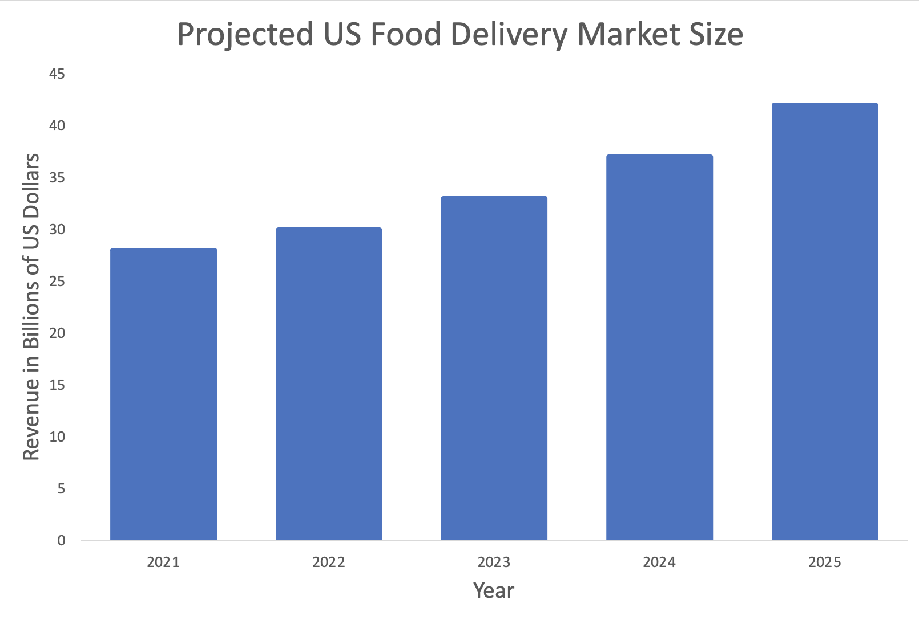
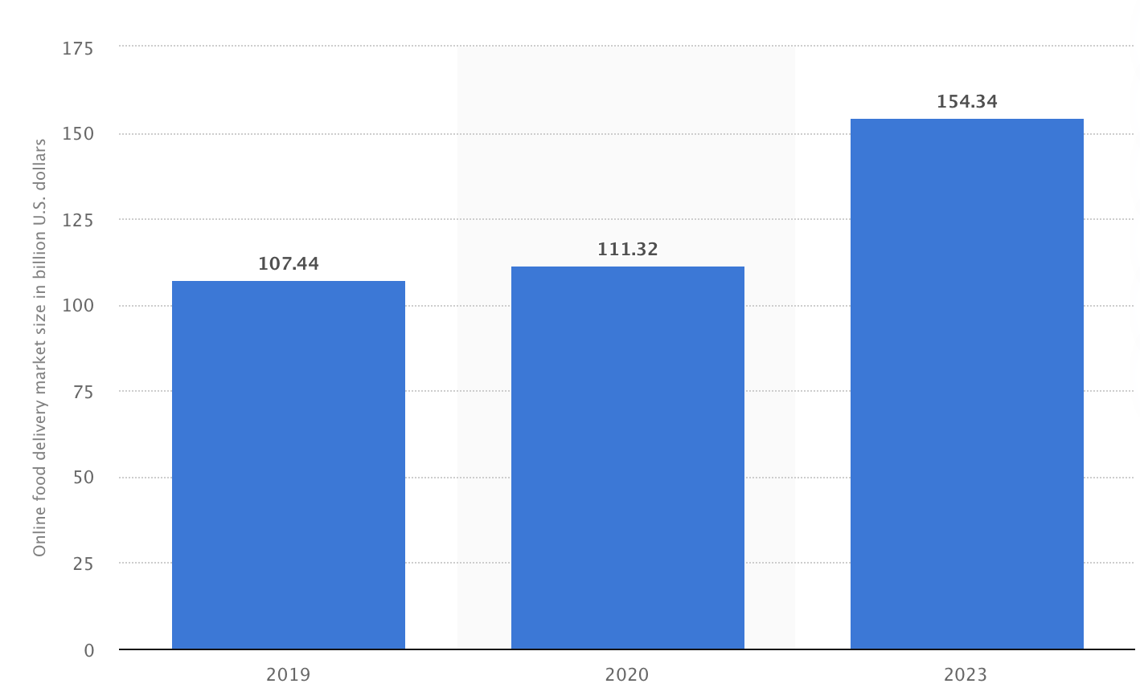
Market Size
Online Food Delivery Global Market Size (in billions of US dollars)
Notes:
https://www.businessofapps.com/data/food-delivery-app-market/
https://www.statista.com/statistics/1170631/online-food-delivery-market-size-worldwide/
The global market size of the online food delivery industry is shown to the left.
From 2020 to 2023 it is projected to increase by around 40 billion dollars.
The graph on the right shows the US market size. Last year there were 26.5 billion dollars in revenue from food delivery services.
The chart shows that the market is projected to continue growing and reaches 42 billion dollars in revenue by 2025.
On the next slide we will discuss who the main brands are in the Industry

Slide 5
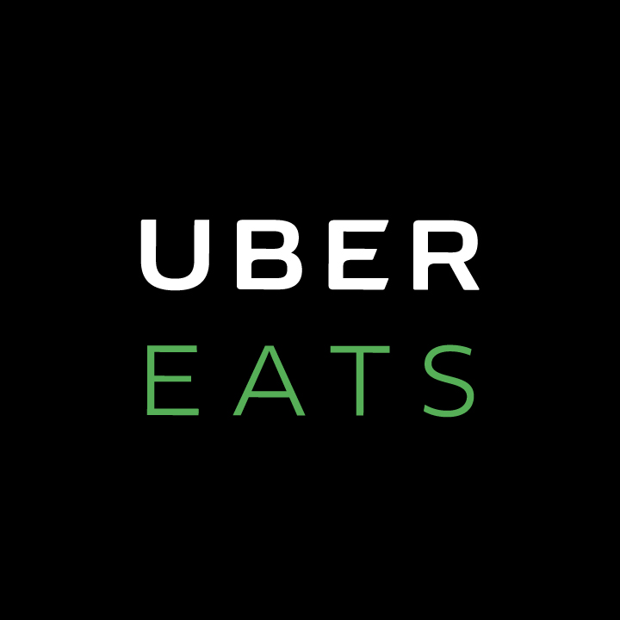


Rivals
In 2020:
18 million users
$2.9 billion in Revenue
In 2020:
66 million users
$4.8 billion in Revenue
In 2020:
31.4 million users
$1.8 billion in Revenue
Notes:
https://www.businessofapps.com/data/doordash-statistics/
https://www.businessofapps.com/data/uber-eats-statistics/
https://www.businessofapps.com/data/grubhub-statistics/
There are three big rivals in the industry which are shown here. DoorDash, Uber Eats and GrubHub
These rivals make up over 80% of the market share which will be discussed futher by Andrew on a future slide.
Throughout 2020 DoorDash had approximately 18 million users and 2.9 billion dollars of revenue.
Uber Eats had 66 million users and 4.8 billion in revenue.
Lastly, GrubHub had 31.4 million users and 1.8 billion dollars of revenue
The competitive rivalry among these brands is high which will be discussed on the next slide.

Slide 6
Highly Competitive Industry
Meal Delivery - U.S. Customer Overlap
How many customers also used a competitor in the first quarter of 2021?
 | DoorDash | Uber Eats | GrubHub
DoorDash | - | 21% | 25%
Uber Eats | 43% | - | 28%
GrubHub | 42% | 22% | -
Ways Rivals Compete
Adding new restaurants
Offering discounts to customers
Improving their website and application designs
Notes:
Chart derived from: https://secondmeasure.com/datapoints/food-delivery-services-grubhub-uber-eats-doordash-postmates/
The chart on the top right shows that most customers are not loyal to a particular food delivery company.
For example, 21% of door dash customers also used uber eats in the first quarter of 2021.
The brands compete by adding new restaurants and offering more of a variety to their customers.
Chain as well as local restaurants are included as options in all three leading brands.
The companies often offer discounts to persuade customers to use their service over another brand.
An example of this would be offering no delivery fees.
Our team has been talking about how many emails we have gotten throughout the past week from the different brands offering money off and waived fees.
We think it may be because of us searching the brands so much.
Lastly, the brands make improvements to their websites and applications to intrigue new customers and retain current ones.
Next, I will turn it over to Jenifer to talk about key performance indicators.

Slide 7
Key Performance Indicators
Platform KPIs
Total Number of Orders
Average Number of Deliveries/Orders Per Hour
Average Profit Per Delivery
Average Order Duration
Sum of Delivery Time ÷ Total Amount of Orders
Driver & Restaurant KPIs
Percentage of Drivers Is On Order or Idle
(Driver On Order ÷ Total Active Drivers) x 100
(Driver On Idle ÷ Total Active Drivers) x 100
Number of Support Tickets
Customer KPIs​
Churn Rate​
(Users at Beginning of Period – Users at end of Period) ÷ Users at the Beginning of the Period​
Customer Lifetime Value​
Average Revenue per Account ÷ Churn Rate​
Net Promoter Score​
% Promotors - % Detractors
Promotors score you 9-10 and detractors score you 0-6
Notes:
With a market this competitive, you know there are teams of people looking at KPIs. We have broken these into three categories including metrics related to the Platform, to the Restaurants and Drivers, and to the Customers. One I want to draw your attention to is the churn rate. Churn Rates tend to fluctuate quite heavily, especially in the food delivery business. But Studies show that over 86 percent of newly acquired customers will stop using a service within two weeks of the launch. The high churn is a result of the low entry barriers in creating a food delivery app as well as the intense amount of competition in the space. So who are the winners and losers?
NPS is separated into three distinctive categories, including:
Detractors (customers giving a score of 0 – 6)
Passives (customers giving a score of 7 or 8)
Promoters (customers giving a score of 9 or 10)

Slide 8
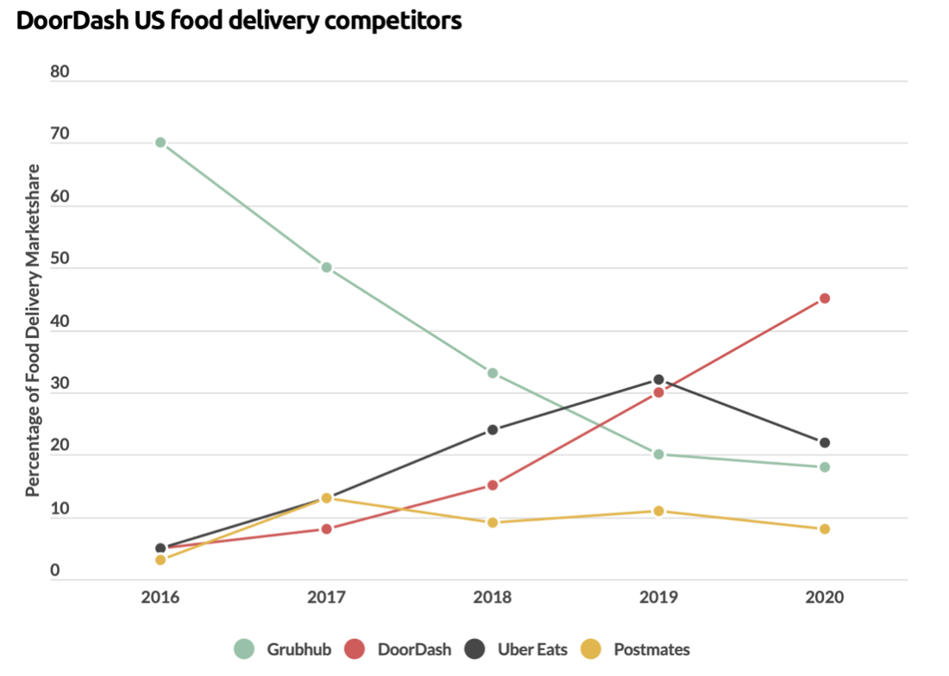
Winners & Losers 2020 US Market Share Door Dash 45% Uber Eats & Postmates 30% GrubHub 18% Uber Eats Acquired Postmates in 2020 Key points: -DoorDash takes the lead, while Grubhub is struggling during the market. -Uber acquired Postmates to consolidate the market and increase their share -DoorDash takes over the market by diversifying their services through alcohol, prescription, and grocery deliveries.
Notes:
Do we need to list the uber postmates twice or can we add parenthesis to the first mention (consolidating the market and increasing their share) then listing something else below?

Slide 9
Key Rivals and Their Positions
 | GrubHub | DoorDash | UberEats
Slogan | “Moving Eating Forward” | “It’s Our Pleasure” | “Get the food you want”
Best for | Deals | Quality | variety
Location |  | 800+ cities & Canada, including Atlanta, Seattle, Boston, New York, and Chicago | 500 + cities and 24 countries
Audience | Urban/City | Suburban | Urban/City
Delivery Fee | Typically, less than $7 | $0-$8 | $1-$10
Subscription | Grubhub+: $9.99 per month (free two-week trial); unlimited free delivery from eligible restaurants and 10% cashback for every $100 you spend | DashPass: $9.99 per month (free one-month trial); zero delivery fees on orders from select restaurants, as well as zero delivery fees and lower service fees on orders over $12 | Eats Pass: $9.99 per month, unlimited free delivery (even during busy hours) and 5% off orders of $15 or more for your region
Also Delivers | Alcohol | Groceries and Alcohol | Alcohol (only in South Florida)

Slide 10
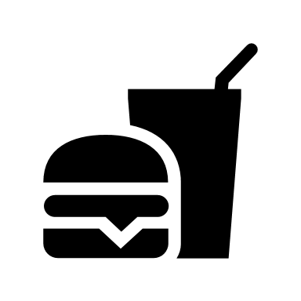

Buyers & Suppliers
There were 111 million US Food Delivery Users in 2020
The number of restaurants included by each of the three largest brands:
DoorDash- 390,000
Uber Eats- 600,000
Grubhub- 265,000
Suppliers: Restaurants that are included in the app or website
Buyers: Those who order the food to be delivered
Who has the Power?
Buyers – high power
Have options (to order delivery, what third party company to use, which restaurant to order from)
Have control over third-party delivery companies unless one 3rd party has a monopoly
Suppliers – low power
Controlled by the third-party delivery company
Commission structure
Restaurants added without consent
Notes:
The suppliers in this case are the restaurants that are included in the app or website.
The buyers are those who decide to order food through online delivery services
In 2020 there were 111 million US food delivery users
The number of restaurants included varied by brand.
DoorDash included 390,000 restaurants
Uber Eats had 600,000
And GrubHub had 265,000
It was interesting to investigate who has the power in this industry.
We decided that the buyers have the most people since they have options like
Do they want to get food delivered using a third party company,
If so, which company do they want to use and they can also choose which restaurant to order the food from
Since there is no monopoly in the business the customers have options which gives them power
On the other hand, the suppliers have a small amount of power.
The third party delivery company decides the commission structure.
Also restaurants are often offered on the apps and websites without their consent
I am now going to turn it over to Hanna to talk about driving forces

Slide 11
Driving Forces
Historical
Third Party Food Delivery Services have been a natural progression of food delivery services that have been evolving since the 1700's with milk delivery services. As the United States started to urbanize the need to have perishable items delivered quickly and conveniently has become the way of life for many Americans.
Current
The major drivers of the industry such as rising disposable incomes, increasing population, rising internet penetrations, growing smartphones sales, and wider choice and convenience offered by the platforms are expected to aid the market growth. The global online food delivery industry is also driven by the hectic lifestyles and rapid urbanization, leading customers to increasingly choose the service. The development of user-friendly food websites and applications and improved logistics are aiding the market growth further.
As the food delivery sector has grown, the "ghost kitchen" segment has also grown. A ghost kitchen is a restaurant space that allows for multiple online restaurants to come and cook and use the space for delivery orders only. They are usually located in urban areas and allow for virtual business to try out their menu ideas without investing fully into a brick-and-mortar space. These "Ghost Kitchens" use delivery apps as the most cost-efficient way to reach customers in their area.
Notes:
Ghost kitchens are also called cloud kitchens or virtual kitchens.

Slide 12
Disruption to the Industry
In-House Delivery Fleets
Many restaurants are looking into in house deliver fleets to lower commission cost with third party vendors as well as gaining back some control on the customer experience as well as gaining additional data on their customer.
Pricing Methodologies
Use of the platform can be dependent on the price of the goods sold, the compensation and gratuities given to retain drivers, and fees and commissions charged to merchants to keep them with the delivery app. As these prices and fees fluctuate it could change the demand for the customer using the app.
COVID – 19
With the COVID-19 pandemic, there has been a significant increase in revenue, and Total Orders due to increased consumer demand for delivery.
More merchants are using deliver app platforms to facilitate both delivery and take-out.
Notes:
https://fortune.com/2021/04/20/restaurants-food-delivery-apps-fees-commission-doordash-uber-eats-grubhub/

Slide 13
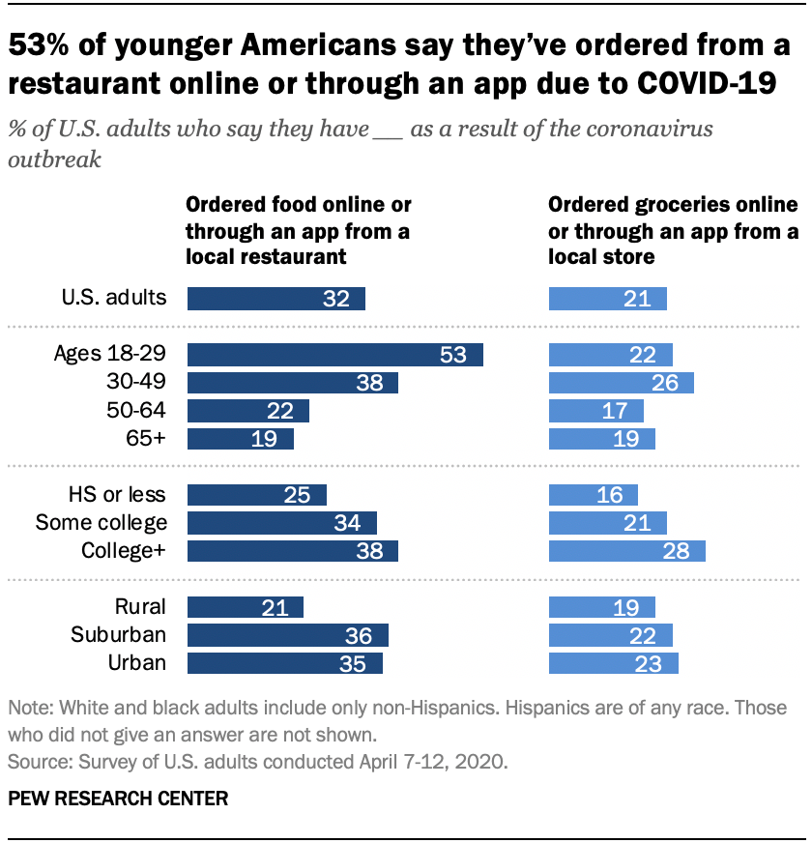
Buyer Segments

Slide 14
Key to Success
The key to success depends on the ability to continue to innovate and update the delivery app. To remain competitive, the big players must find their "golden handcuffs", in other words a hook that sets them apart from the rest and allows for users to become brand loyal to one company.
It is key that the website and mobile app and the suite of merchant services that they offer through their platform like payment, maps, restaurant listings, and analytics stay up to date.
If they fail to expand the suite of merchant services they offer through their platform, the ability to retain and acquire new restaurants could be affected. Gaining and retaining new and existing merchants is crucial in satisfying customer needs.
The business needs to introduce new offerings that are current with new technologies, stay on top of new industry standards as new practices emerge.
Future success could depend on the ability to respond to technological advances and emerging industry standards and practices in a cost-effective and timely manner.
Notes:
Ease of use? Marketing campaign. check the wording of the third bullet. I think they need to earn loyalty. Right now they are all overspending to get someone to try the site once but they are not getting that person to become loyal. This is especially true of younger generations. Build loyalty/repeat customers
Add something that keeps the customer as a hook. Golden handcuffs – how they will keep their customers loyal to them and just them.
How many of you shop around between multiple apps.
On first point – you may want to mention that each company is currently hemorrhaging money trying to get first time buyers and return buyers.

Slide 15
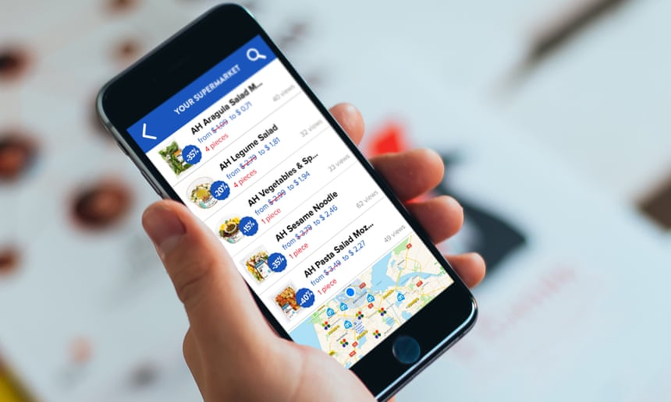
How Suppliers (Restaurants) Benefit
Allows restaurant owners to offer delivery service without employing and managing extra employees, saving owners time and energy
Allows restaurants to increase revenues above the limits of their seating capacity
Advertising. New customers may discover the restaurant because it is on the delivery site.
During COVID, delivery services helped some restaurants stay open or transform into "ghost restaurants"
Notes:
Several of the keys to success revolve around the suppliers but why should the suppliers (the restaurants) like the 3rd parties
Read screen.

Slide 16
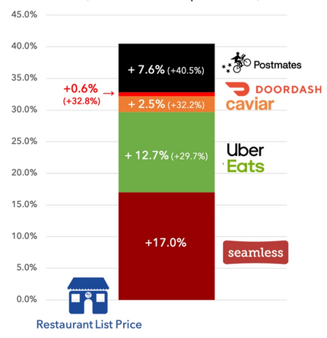
Why Suppliers (Restaurants) Dislike
Restaurants are low margin businesses, and the delivery companies charge high commissions. On average the apps keep 30% of the food total.
DoorDash, Postmates and Grubhub have all been sued for listing restaurants without permission, but it is now a standard practice. This practice allows the 3rd parties to look more robust to customers and helps them coerce restaurants to join. Restaurants say it can damage their reputation (some food does not travel well), they lose control over their customers dining experience, it reduces demand for their own delivery service, and they lose control of their online presence.
There are a growing number of complaints of food being substituted with another restaurants food without telling the customer. A customer orders a pizza from their favorite pizzeria but it arrives in a different box than usual and has a very different taste. After complaining to the restaurant, they learn it did not come from them.
Some contracts with restaurants limit their ability to charge different prices for dine in or delivery. There have been lawsuits for price-fixing and monopoly.
Notes:
Basic process: Customer orders on app and pays the app for food, tax, processing fee, convenience fee, and delivery fee (or some combination – there is usually one hidden in with taxes that you have not noticed). The app then pays a portion of the food part of the bill, along with the relevant tax, to the restaurant. These fees average ~30% commission but can be much higher. Fees do vary by site with larger chain restaurants getting better negotiated rates than a local restaurant with one location. So you buy a $12 burger, Grubhub charges you $23 and the restaurant gets $8.40. To combat the chunk of revenues the app takes, some restaurants have been known to serve smaller portions when they know the order is through an app to protect their margins. But that is only if they know it an app order which brings us to the next point.
Restaurants are being listed on sites without their permission! In these cases there is no negotiated payment structure, instead, the site puts a copy of the restaurants menu up on their site but sometimes at inflated costs and other times with an added fee to the customer. The app collects payment from the customer including the added fees, processing, and delivery and they then contact the restaurant and place an order and pick up the order as if they are the end customer. Problems arise when the restaurant changes their menu but the app does not keep up which happens frequently. When the restaurant cannot fill the order for their old items, the app cancels it and blames the restaurant! When menus are marked up, those who have been to the restaurant before are surprised the $12 salad they bought in person last week is now $18 and thinks the restaurant raised prices when they have not. This customer may not return to the restaurant in person in the future thinking their prices are too high. Seattle introduced a bill just yesterday to require restaurant permission to be listed. California put this into effect on January 1.
Fake Restaurants or substituted: This is the continuation of the last. The customers thinks they are ordering from their favorite pizza place but the pizza they receive is definitely not from there. Since the 3rd party does not have a relationship with the actual restaurant, they have to manually place the order ---- and all pizza is the same right? I don't know if this out of convenance? Because one restaurant less expensive? A deal with one restaurant? Whatever the reason, they can KILL the real restaurants reputation.
Though there are many other issues, the last I will mention is some contracts don't allow restaurants to have different pricing for eat in or delivery causing some restaurants to sue.
https://techcrunch.com/2020/03/16/the-hidden-cost-of-food-delivery/

Slide 17

Dilemmas and Business Issues
Several states and localities have introduced temporary caps on food delivery fees for restaurants of ~15% average, due to Covid. 3rd parties retaliated adding market specific fees
California passed legislation to ban apps from listing a restaurant without permission (NY in the works)
Lawsuits related to fees, competition, price restraints and more
Restaurant industry push to order direct. More restaurants have added capabilities to their own websites for accepting orders.
Local competition with lower fees: some backed, or owned, by their Suppliers
Business/Operational issues: Staffing, Supplier Relations, Customer Relations, Competition, Profitability
Notes:
If you want to go into this industry, here are some business Dilemmas that need to be solved.
Due to Covid, Several states and localities including Chicago, Massachussetts, Las Vegas, LA, and NYC have put temporary caps on how much commission the 3rd parties can charge. Most around 15 to 20% cap. Will they go permanent?
The sites pushed back in Chicago adding - "chicago fee" of $1.50 per order to balance out the cap
Numerous other lawsuits face the industry address fees, anti-trust, monopolies, price restraints --- the list goes one
During covid the 3rd party sites have pushed to order delivery to "save your favorite restaurant" but restaurants have pushed to order direct. Many restaurants signed up with companies that would allow them get carry out orders through their website at a much lower cost.
Then there are the more common issues that many industries face including staffing which is very hard right now. Profitability has been as issue for several with high spending to get new customers.
The emerging threat is new competition from local restaurant backed delivery sites.

Slide 18
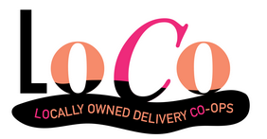
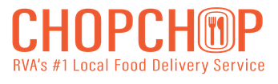

Local Delivery Services - Competition
Charge Restaurants a 16% commission. Locally Owned by EAT Restaurant Partners
A franchise the encourages local restaurants to form a coop. In 6 cities including Richmond
What if the National Restaurant Association created a national site with reasonable rates to support their members?
Notes:
How many of you try to avoid using one of these services? To combat the high fees of the market leaders, local delivery services are popping up. One example in Richmond is Chop Chop which is owned by EAT Restaurants Partners owners of 14 Richmond restaurants including Fat Dragon, Foo Dog, Red Salt and Osaka. They charge 16% commission which is about half of the industry average. LoCo Richmond is another example. They opened in 2021. They are owned by local restaurants and state there commissions to restaurants are substantially lower than competitors. They are actually a franchise. The franchise page says: Band together with the restaurants in your community to form a local delivery co-op that’s independently owned, operated, and controlled. There are franchises currently in Knoxville, Nashville, Omaha, Richmond, Las Vegas, and Tampa Bay. What % share could this pull from the big guys? What if they were heavily supported by the restaurants as a way to get delivery - without killing their bottom line. Whether in one city or a franchise in many cities, these are still small competitors in individual markets . . . but what is the National Restaurant Association started their own delivery app to support their members? A national site that would do everything the industry leaders do but at a lower cost to restaurants.

Slide 19

Cost of Entry
Initial cost include
Market Research
App Development
Fuel cost
Salaries for Permanent employees.
Marketing*
Cost are low
Cost to company include:
Site Maintenance
Employees – Drivers are paid as they go based on how many deliveries they make - tips
Restaurants pay your commissions for listing their business on your website + upsell restaurants for advertising
Cost to Maintain
Building a
Third-Party Delivery Service in your city
Built in Suppliers
Low Cost to
Get Started
You have no lingering product
If the market you are in gets too saturated, you can move markets The App can be easily transferable and duplicated in markets across the United States
Restaurants are your suppliers
A service where the restaurants in your area provides the product
Easy to Leave

